Slide 1
RTB - IBD
Apr 2022

Slide 2
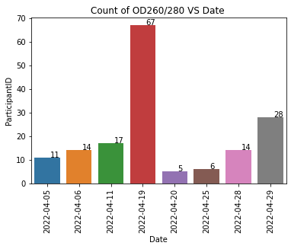
BIO Resource
 | OD 260/280 | OD 260/230 | Concentration
Blood | 1.75 - 2.04 | >1.5 | > 30ng/ul

Slide 3
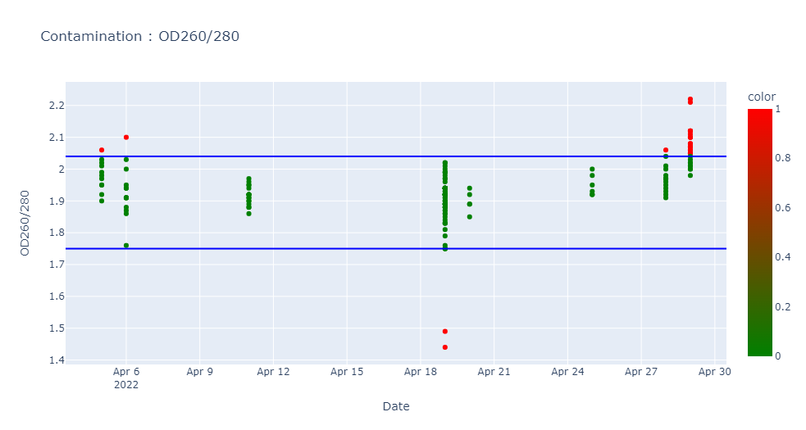
Contamination : OD260/280 (1.75 – 2.04)
ParticipantID | Date | OD260/280 | OD260/230 | Concentration
K041090M | 05/04/2022 | 2.06 | 2.44 | 158.34
K026005Q | 06/04/2022 | 2.1 | 2.04 | 44.68
K042598B | 19/04/2022 | 1.49 | 0.75 | 189.68
K042608M | 19/04/2022 | 1.44 | 0.77 | 212.75
K035554V | 28/04/2022 | 2.06 | 2.34 | 205.33
K041917L | 29/04/2022 | 2.07 | 2.46 | 85.41
K025924C | 29/04/2022 | 2.06 | 2.4 | 81.33
K041918M | 29/04/2022 | 2.05 | 2.11 | 90.38
K041916K | 29/04/2022 | 2.08 | 2.9 | 67.09
K042606K | 29/04/2022 | 2.07 | 2.53 | 84.44
K038468M | 29/04/2022 | 2.12 | 2.25 | 82.11
K030238R | 29/04/2022 | 2.1 | 2.65 | 66.99
K041965N | 29/04/2022 | 2.07 | 2.64 | 101.87
K040654N | 29/04/2022 | 2.1 | 2.45 | 85.59
K042226X | 29/04/2022 | 2.08 | 2.4 | 71.22
K042580G | 29/04/2022 | 2.21 | 2.58 | 62.24
K042811H | 29/04/2022 | 2.06 | 2.51 | 120.28
K042824X | 29/04/2022 | 2.05 | 2.6 | 89.2
K035420Z | 29/04/2022 | 2.11 | 2.55 | 102.95
K025777S | 29/04/2022 | 2.05 | 1.81 | 116.97
K042227Y | 29/04/2022 | 2.1 | 2.54 | 57.85
K006721E | 29/04/2022 | 2.12 | 2.69 | 93.14
K041964M | 29/04/2022 | 2.22 | 3.03 | 48.57
K042561L | 29/04/2022 | 2.12 | 2.84 | 44.58

Slide 4
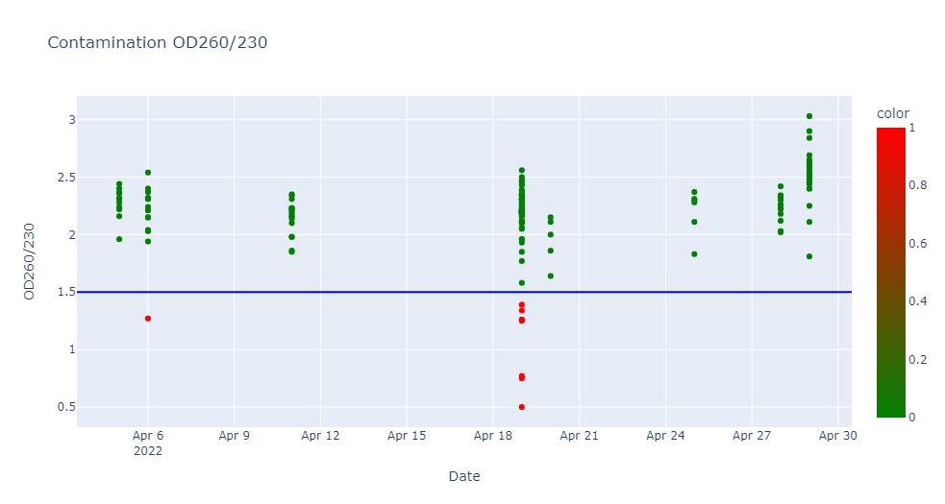
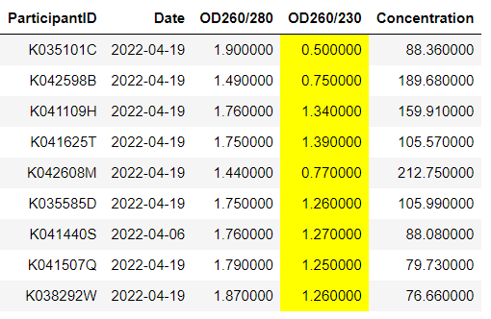
Contamination : OD260/230 (>1.5)

Slide 5
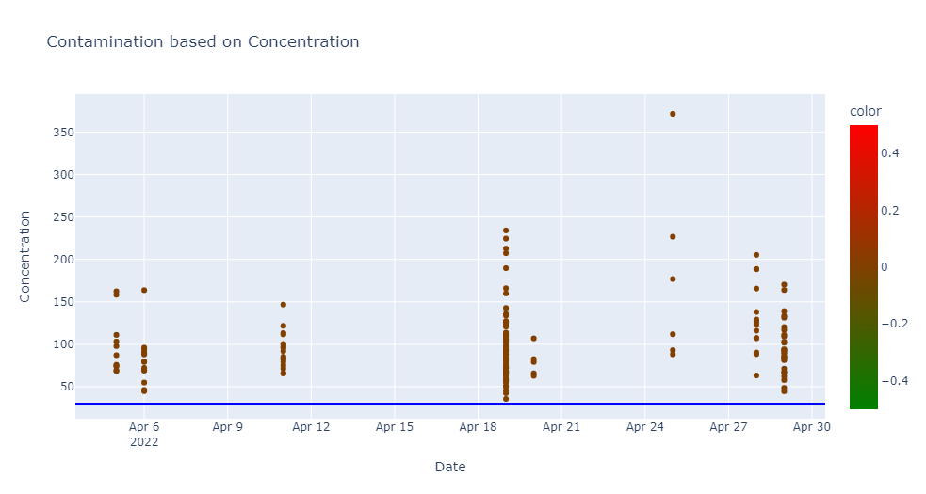
Contamination : Concentration (> 30 ng/ul)
There is NO contamination in the concentration. (ie) All the samples have > 30 ng/ul concentration.

